Slide 1
Public Transport Optimization
IOT_PHASE 5

Slide 2
CONTENTS OF THIS TEMPLATE:
Introduction
PROJECT Objectives
IOT device setup
Platform Development
Project Explanation
IOT SEnSORS IN PUBLic TRANSPORT VEHIClES
Code ImplementatioN
ADVANTAGES
Application
Conclusion

Slide 3
INTRODUCTION:
Public transport Optimization is crucial for providing accessible mobility in cities and communities.
It goes beyond trams, buses, and trolleybuses, often including minibuses. Public transport enables people to reach work, housing, education, and leisure activities efficiently and economically, particularly in densely populated areas.
As a socially important service, public transport is typically provided or regulated by the government. However, capital investments in its development are rarely fully recovered, and operating costs are often not covered by fares.
The value of public transport lies in time and resource savings for people’s mobility, which contributes to increased GDP.
Access to high-speed public transport can also enhance the value of real estate through transit-oriented development.

Slide 4
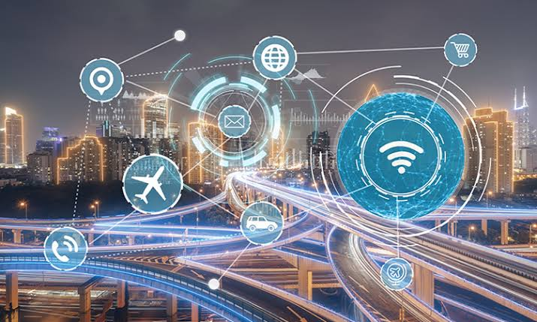
PROJECT OBJECTIVES:
The objective of this project is to optimize public transportation systems by leveraging the Internet of Things (IoT) technology.
The project aims to enhance the efficiency, reliability, and overall user experience of public transportation services by collecting and analyzing real-time data from IoT devices deployed in vehicles, infrastructure, and passenger hubs.

Slide 5
IOT DEVICE SETUP:
Vehicle Sensors: IoT sensors will be installed in public transport vehicles, including buses, trams, and trains. These sensors will collect data such as vehicle location, speed, fuel consumption, passenger count, and engine health.
Passenger Counters: IoT cameras or sensors will be placed at vehicle entry and exit points to track passenger counts and occupancy in real-time.
Infrastructure Sensors: IoT sensors will be deployed at bus stops, train stations, and other passenger hubs to collect data on passenger foot traffic, environmental conditions (e.g., temperature, humidity), and vehicle arrival times.

Slide 6
PLATFORM DEVELOPMENT:
The IoT data collected from the devices will be transmitted to a centralized platform for analysis and decision-making. The platform will consist of the following components:
IoT Gateway: Data from the IoT devices will be sent to a central gateway for aggregation and forwarding. This gateway will be responsible for data preprocessing and transmission.
Cloud Data Storage: The preprocessed data will be stored in a cloud-based database for real-time and historical analysis.
Data Analysis and Prediction: Machine learning models will be developed to analyze the data and make predictions about vehicle schedules, maintenance needs, and passenger demand.
Dashboard: A user-friendly dashboard will be created for transportation authorities and commuters to access real-time information about vehicle locations, passenger counts, and estimated arrival times.

Slide 7
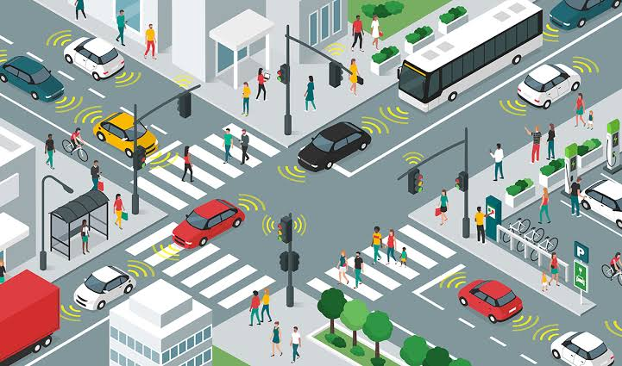
PROJECT EXPLANATION:
The system will collect real-time data on vehicle locations, passenger counts, and environmental conditions. This data will be analyzed to optimize transportation routes, schedules, and vehicle maintenance.
Passengers will have access to accurate arrival time predictions, reducing wait times and improving their experience. Transportation authorities will have tools to make data-driven decisions to enhance the efficiency and reliability of their services.
The project's success will lead to more sustainable, convenient, and user-friendly public transportation systems, benefiting both commuters and the environment.

Slide 8
IOT SENSORS IN PUBLIC TRANSPORT VEHICLES:
To effectively monitor ridership, track vehicle locations, and predict arrival times, we need a well-planned deployment of IoT sensors in public transportation vehicles.
Here's a step-by-step plan for deploying these sensors:
a. GPS Sensors:
Select high-accuracy GPS sensors capable of realtime tracking and location data transmission.
b. Passenger Counters:
Choose reliable passenger counting sensors that accurately record the number of passengers entering and exiting the vehicle.

Slide 9
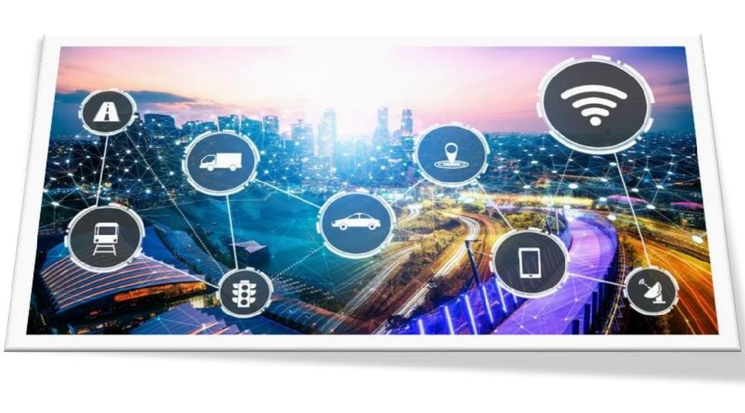
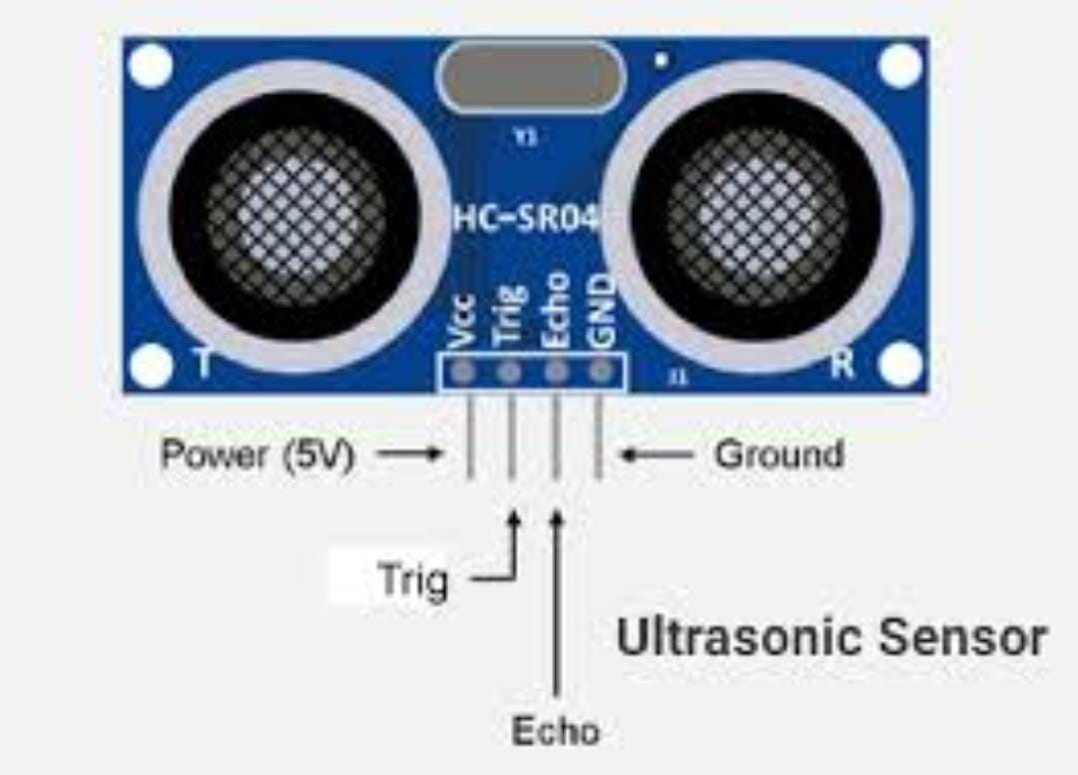
sensors(images):
C.Proximity Sensors (Ultrasonic or Infrared):
Application: Detecting the proximity of vehicles to obstacles, objects, or pedestrians.
Benefits: Enhances safety by providing alerts to drivers and helping avoid collisions.
Camera Sensors (CCTV):Application: Surveillance and monitoring of passengers, driver behavior, and security.

Slide 10
CODE IMPLEMENTATION:
Platform UI Code for Public Transport Optimization:
<!DOCTYPE html>
<html>
<head>
<title>Bus Passenger Counter</title>
</head>
<body>
<h1>Bus Passenger Counter</h1>
<p>Passenger Count: <span id="passengerCount">Loading...</span></p> <script>
// Function to update passenger count from ThingSpeak
function updatePassengerCount() {

Slide 11
// Make an AJAX request to fetch the passenger count from ThingSpeak
var xhr = new XMLHttpRequest();
xhr.open("GET", "https://api.thingspeak.com/update?api_key=OL6MICDSS2G0VN7J&field1=0", true);
xhr.onreadystatechange = function () {
if (xhr.readyState == 4 && xhr.status == 200) {
var count = xhr.responseText;
document.getElementById("passengerCount").textContent = count;
}
};
xhr.send();
}
// Periodically update passenger count (e.g., every 10 seconds)
setInterval(updatePassengerCount, 10000);
// Initial update
updatePassengerCount();
</script>
</body>
</html>

Slide 12
OUTPUT:
Bus Passenger Counter
Passenger Count: 12
PYTHON SCRIPT:
#define BLYNK_TEMPLATE_ID "TMPL26V4fGv5q“
#define BLYNK_TEMPLATE_NAME "Test“
#define BLYNK_AUTH_TOKEN
"XEHxNF_Ur1Nt2p7wB5B20dNI1ZUwj34P“
#include <WiFi.h>
#include <WiFiClient.h>
#include <BlynkSimpleEsp32.h>
int duration1 = 0;
int distance1 = 0;
int duration2 = 0;
int distance2 = 0;
int dis1 = 0;
int dis2 = 0;
int dis_new1 = 0;
int dis_new2 = 0;
int entered = 0;
int left = 0;
int inside = 0;

Slide 13
#define LED 2
#define PIN_TRIG1 15
#define PIN_ECHO1 14
#define PIN_TRIG2 13
#define PIN_ECHO2 12
BlynkTimer timer;
char auth[] = BLYNK_AUTH_TOKEN;
char ssid[] = "Wokwi-GUEST"; // your network
SSID (name)
char pass[] = "";
#define BLYNK_PRINT Serial
long get_distance1() {
// Start a new measurement:
digitalWrite(PIN_TRIG1, HIGH);
delayMicroseconds(10);
digitalWrite(PIN_TRIG1, LOW);
// Read the result:
duration1 = pulseIn(PIN_ECHO1, HIGH);
distance1 = duration1 / 58;
return distance1;
}

Slide 14
long get_distance2() {
// Start a new measurement:
digitalWrite(PIN_TRIG2, HIGH);
delayMicroseconds(10);
digitalWrite(PIN_TRIG2, LOW);
// Read the result:
duration2 = pulseIn(PIN_ECHO2, HIGH);
distance2 = duration2 / 58;
return distance2;
}
void myTimer() {
Serial.println("100");
dis_new1 = get_distance1();
dis_new2 = get_distance2();
if (dis1 != dis_new1 || dis2 != dis_new2){
Serial.println("200");
if (dis1 < dis2){
Serial.println("Enter loop");
entered = entered + 1;
inside = inside + 1;
digitalWrite(LED, HIGH);
Blynk.virtualWrite(V0, entered);
Blynk.virtualWrite(V2, inside);
dis1 = dis_new1;
delay(1000);
digitalWrite(LED, LOW);
}

Slide 15
if (dis1 > dis2){
Serial.println("Leave loop");
left = left + 1;
inside = inside - 1;
Blynk.virtualWrite(V1, left);
Blynk.virtualWrite(V2, inside);
dis2 = dis_new2;
delay(1000);
}
}
}
void setup() {
Serial.begin(115200);
pinMode(LED, OUTPUT);
pinMode(PIN_TRIG1, OUTPUT);
pinMode(PIN_ECHO1, INPUT);
pinMode(PIN_TRIG2, OUTPUT);

Slide 16
pinMode(PIN_ECHO2, INPUT);
Blynk.begin(auth, ssid, pass, "blynk.cloud", 8080);
timer.setInterval(1000L, myTimer);
}
void loop() {
Blynk.run();
timer.run();
}

Slide 17
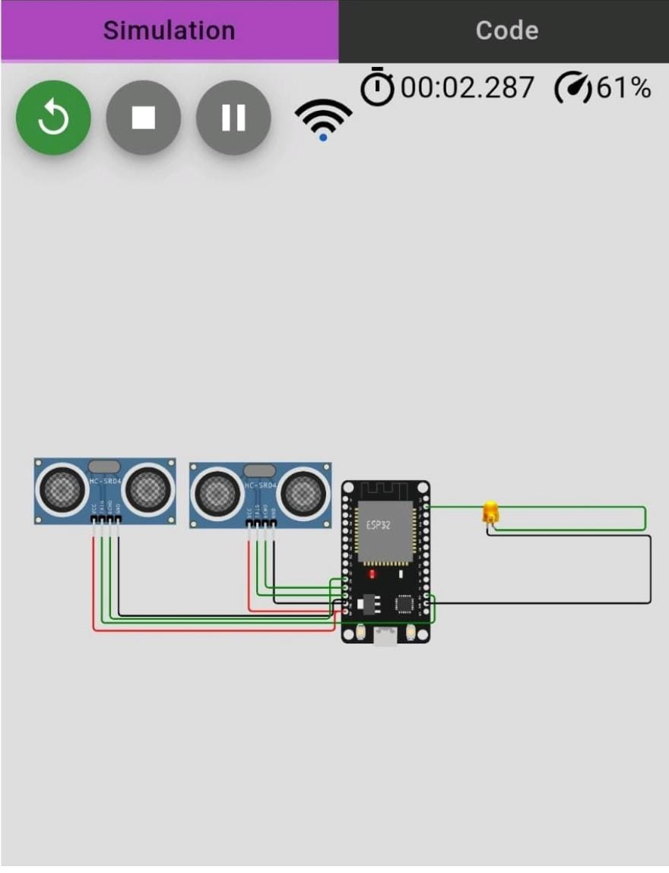
OUTPUT:

Slide 18
ADVANTAGES:
Preservation of the environment.
Increased performance of companies, vehicles…
Increased safety.
Collecting and analyzing data on the state of the roads or the appearance of obstacles helps the population (drivers, pedestrians…) to have fewer chances of having an accident.
Better customer experience, both for those waiting for goods to arrive and for those who use public transport or electric and autonomous vehicles.
The brand image is also, therefore, more positive.Improved facilities.
Train stations, airports, bus shelters… Everything that surrounds means of transport can also be optimized with the information provided by sensors.

Slide 19
APPLICATIONS:
The IoT for public safety market encompasses a wide range of applications, including emergency response, video surveillance, traffic management, and crowd control.
One of the primary benefits of IoT for public safety is the ability to gather IoT in transportation can also be used to design steering wheel control system.
IoT in transportation can also be used to design steering wheel control systems.

Slide 20
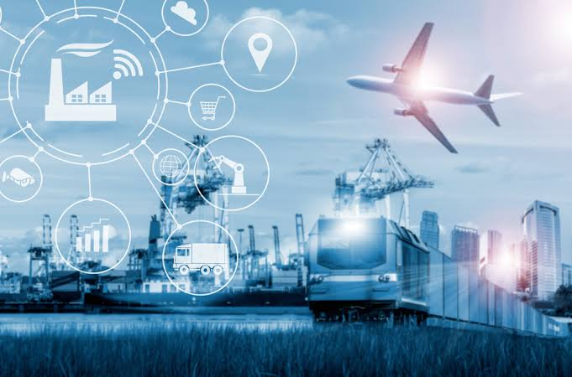
CONCLUSION:
Generally speaking, public transport is far more efficient and environment-friendly for cities than the means of personal transport.
It can be difficult at first for people to stop using their cars, but as a result it will be better for everyone.

Slide 21
THANK YOU…

